Slide 1
Handling Events

Slide 2


What is an Event in Java?
Def^{n}: - in programming, an event is (in most cases) an action taken by the user.
Types of events:
  1) the user presses a key or clicks the mouse button.
  2) the user clicks on a button, a choice, a checkbox, etc.
Thus, rather than a program be executed as a long sequence of instructions, like the following:
We have sections of the program which can be activated by the occurrence of an event.
Sequential Execution

Slide 3
Basic Event Handling
Listeners
Add
Listeners
Handle the
Events
GUI
Program-
specific
Action handlers
Event
Effects
  The GUI is responsible for constructing the user interface and for connecting (registering) widgets to listeners
  The listener part implements the appropriate interface for the type of event(s) of interest.
  The code (in the action handler) that performs the program’s action associated with the event(s).

Slide 4
The Event Loop
In Java, the programmer creates a section(s) of code (methods) which will be automatically invoked whenever an event happens.
Details of the event (the name of the button that was pressed, the choice box that was changed, the radio button that was pressed, etc) are returned to the programmer so that the required processing takes place.
In Java, events are classified into several classes (we will study the following):
  1) ActionEvents - generated whenever a change is made to a JButton, JCheckBox, JComboBox, JTextField, or JRadioButton..
  2) TextEvents - generated whenever a change is made to an AWT TextArea or an AWT TextField (not implemented in swing).
  3) ItemEvents - generated whenever a change is made to a JButton, JCheckBox, JComboBox, or JRadioButton.
The software cycles around in a loop waiting for an event to occur:
Button
pressed?
Choice made?
Event
loop
Radio button pressed?
  Etc…

Slide 5
Event Handlers that We Will Study
Event Class | Listener Interface Methods | Association Methods | Generated by Class
ActionEvent | interface ActionListener | addActionListener | JButton
 | actionPerformed(ActionEvent) | removeActionListener | JCheckBox
 |  |  | JComboBox
 |  |  | JTextField
 |  |  | JRadioButton
ItemEvent | interface ItemListener | addItemListener | JCheckBox
 | itemStateChanged(ItemEvent) | removeItemListener | JRadioButton
 |  |  | JComboBox
MouseEvent | interface MouseListener | addMouseListener | generated by mouse
 | mousePressed(MouseEvent) | removeMouseListener | event on any component
 | mouseReleased(MouseEvent)
 | mouseEntered(MouseEvent)
 | mouseExited(MouseEvent)
 | mouseClicked(MouseEvent)
Listener interfaces and related classes

Slide 6
Using Action Events
Import the required event classes; thus giving your applet the power to receive and handle messages, such as those sent when a button is clicked or the mouse is moved.
    import java.awt.event.*;
State that the class implements an ActionListener.
  public class IRS extends JApplet implements ActionListener
3&4. Declare and create a button variable, giving it an appropriate name.
JButton calculate = new JButton("Calculate now");
5. Add the button to the applet window.
add(calculate);
6. Inform the button that this object will respond to button events, using addActionListener.
calculate.addActionListener(this);
Note: this acts like the word “me” in English. It refers to the applet itself. The message says, in effect, “send me a message whenever the calculate button it clicked: I’m listening.”
7. Provide a method called actionPerformed() to be invoked when a button click event occurs.
public void actionPerformed( ActionEvent e )

Slide 7
What are the Parts?
import java.awt.*;
import javax.swing.*;
import java.awt.event.*;
public class IRS extends JApplet implements ActionListener
{
// normal declarations for JTextFields, JLabels, JPanels, and
// other widgets needed for the user interface
JButton calculate = new JButton("Calculate now"); // button for user to use
public void init()
{
// define layout methods to be used and add the various
// GUI components to create the user interface
somepanel.add(calculate);
calculate.addActionListener(this);
}
public void actionPerformed( ActionEvent e )
{
// local variable declarations and Java code required to calculate
// taxes owed and net pay given an employee name, ssn, gross
// salary earned, number of dependents, and marital status }
}
}
Step #1
Step #2
Steps #3 & 4
Step #5
Step #6
Step #7

Slide 8

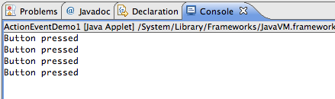
Action Event Demo1
import java.awt.*;
import javax.swing.*;
import java.awt.event.*;
public class ActionEventDemo1 extends JApplet implements ActionListener
{
JButton b1 = new JButton("Submit");
public void init()
{
setLayout(new FlowLayout());
add(b1);
b1.addActionListener(this);
}
public void actionPerformed(ActionEvent e)
{
System.out.println("Button pressed");
}
}

Slide 9
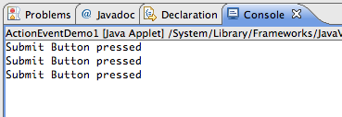
Action Event Demo2
import java.awt.*;
import javax.swing.*;
import java.awt.event.*;
public class ActionEventDemo1 extends JApplet implements ActionListener
{
JButton b1 = new JButton("Submit");
public void init()
{
setLayout(new FlowLayout());
add(b1);
b1.addActionListener(this);
}
public void actionPerformed(ActionEvent e)
{
String s = b1.getText(); //Gets the label off of the button
System.out.println(s + " Button pressed");
}
}

Slide 10
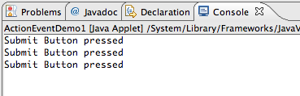
Action Event Demo3
import java.awt.*;
import javax.swing.*;
import java.awt.event.*;
public class ActionEventDemo1 extends JApplet implements ActionListener
{
JButton b1 = new JButton("Submit");
public void init()
{
setLayout(new FlowLayout());
add(b1);
b1.addActionListener(this);
}
public void actionPerformed(ActionEvent e)
{
String s = e.getActionCommand(); //returns the command string associated with event
System.out.println(s + " Button pressed");
}
}

Slide 11
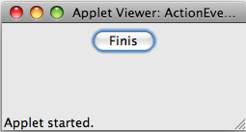
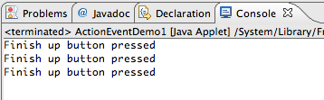
Action Event Demo4
import java.awt.*;
import javax.swing.*;
import java.awt.event.*;
public class ActionEventDemo1 extends JApplet implements ActionListener
{
JButton b1 = new JButton(”Finis");
public void init()
{
setLayout(new FlowLayout());
add(b1);
b1.addActionListener(this);
b1.setActionCommand("Finish up button pressed");
}
public void actionPerformed(ActionEvent e)
{
String s = b1.getActionCommand(); //returns the parameter string for setActionCommand
System.out.println(s + " Button pressed");
}
}
There may be times that a different internal name is more meaningful than the string used to label the button (e.g., an application meant to be used in France might have a button with a French label – but but with a more meaningful internal English name.

Slide 12
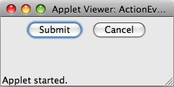
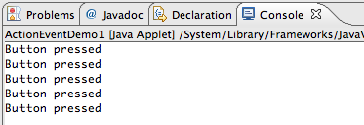
Action Event Demo5
import java.awt.*;
import javax.swing.*;
import java.awt.event.*;
public class ActionEventDemo1 extends JApplet implements ActionListener
{
JButton b1 = new JButton("Submit");
JButton b2 = new JButton("Cancel");
public void init()
{
setLayout(new FlowLayout());
add(b1);
b1.addActionListener(this);
add(b2);
b2.addActionListener(this);
}
public void actionPerformed(ActionEvent e)
{
System.out.println("Button pressed");
}
}
The problem is that this program does not distinguish between the two buttons.

Slide 13
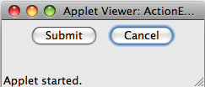
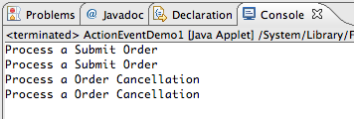
Action Event Demo6
import java.awt.*;
import javax.swing.*;
import java.awt.event.*;
public class ActionEventDemo1 extends JApplet implements ActionListener
{
JButton b1 = new JButton("Submit");
JButton b2 = new JButton("Cancel");
public void init()
{
setLayout(new FlowLayout());
add(b1);
b1.addActionListener(this);
b1.setActionCommand("Process a Submit Order");
add(b2);
b2.addActionListener(this);
b2.setActionCommand("Process a Order Cancellation");
}
public void actionPerformed(ActionEvent e)
{
System.out.println(e.getActionCommand());
}
}

Slide 14
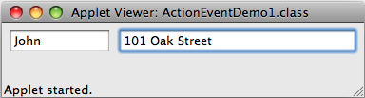
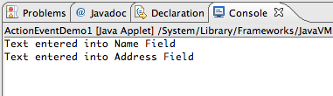
Event Demo(getActionCommand on JTextField)
import java.awt.*;
import javax.swing.*;
import java.awt.event.*;
public class ActionEventDemo1 extends JApplet implements ActionListener
{
JTextField tf1 = new JTextField(8);
JTextField tf2 = new JTextField(20);
public void init()
{
setLayout(new FlowLayout());
add(tf1);
tf1.addActionListener(this);
tf1.setActionCommand("Text entered into Name Field");
add(tf2);
tf2.addActionListener(this);
tf2.setActionCommand("Text entered into Address Field");
}
public void actionPerformed(ActionEvent e)
{
String s = e.getActionCommand();
System.out.println(s);
}
}

Slide 15

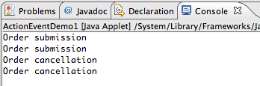
Action Event Demo7
import java.awt.*;
import javax.swing.*;
import java.awt.event.*;
public class ActionEventDemo1 extends JApplet implements ActionListener
{
JButton b1 = new JButton("Submit");
JButton b2 = new JButton("Cancel");
public void init()
{
setLayout(new FlowLayout());
add(b1);
b1.addActionListener(this);
add(b2);
b2.addActionListener(this);
}
public void processSubmit()
{
//code for processing an order submission
System.out.println("Order submission");
}
public void processCancel()
{
//code for processing an order cancellation
System.out.println("Order cancellation");
}
public void actionPerformed(ActionEvent e)
{
if (e.getSource()==b1)
processSubmit(); //invoke the processSubmit method
else
processCancel(); //invoke the processCancel method
}
}

Slide 16



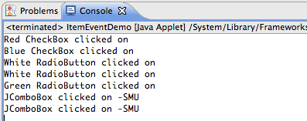
Other Events (ItemEvents)

Slide 17


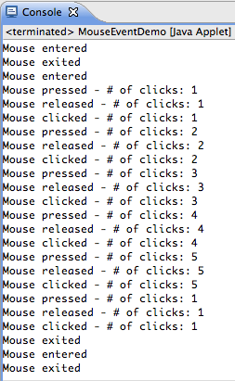
Other Events (MouseEvents)

Slide 18
MouseEvents
Mouse events are generated by the following types of user interaction:
  A mouse click
  A mouse entering a component's area
  A mouse leaving a component's area
Any component can generate these events, and a class must implement the MouseListener interface to support them.
Methods:
void mouseClicked(MouseEvent e) – invoked when the mouse button has been clicked (pressed and released) on a component.
void mouseDragged(MouseEvent e) – invoked when a mouse button is pressed on a component and then dragged.
void mouseEntered(MouseEvent e) - Invoked when the mouse enters a component.
void mouseExited(MouseEvent e) - Invoked when the mouse exits a component.
void mouseMoved(MouseEvent e) - Invoked when the mouse cursor has been moved onto a component but no buttons have been pushed.
void mousePressed(MouseEvent e) - Invoked when a mouse button has been pressed on a component.
void mouseReleased(MouseEvent e) - Invoked when a mouse button has been released on a component.
void mouseDragged(MouseEvent e) -Invoked when a mouse button is pressed on a component and then
dragged.

Slide 19
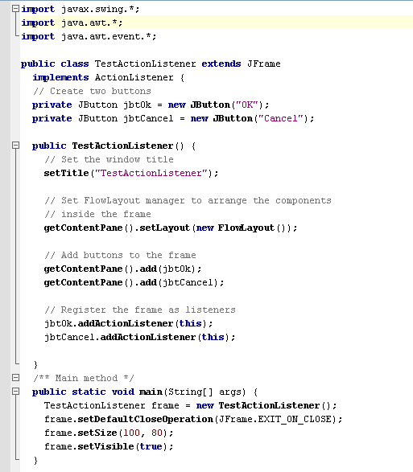
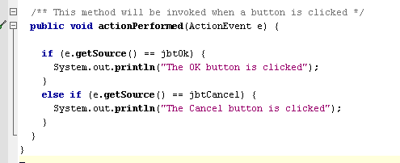
Handling Simple Action Events
The method for responding to an Action event.
Implementing the listener interface
Registering the frame to be a listener for action events generated by the two buttons

Slide 20
Handling Simple Action Events –
a closer look at the event-handling method
actionPerformed is a method
required for all ActionListeners
An Event object’s getSource() method returns a reference to the Component object that generated the event.

Slide 21
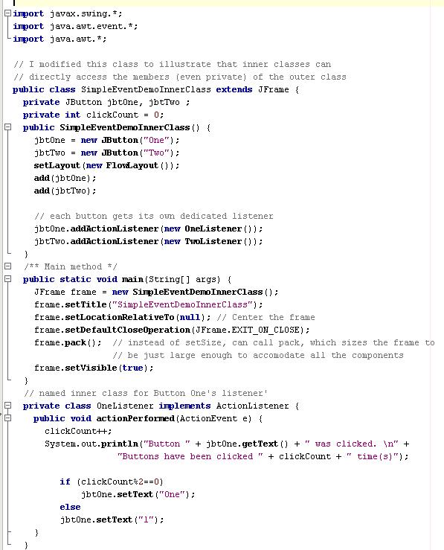
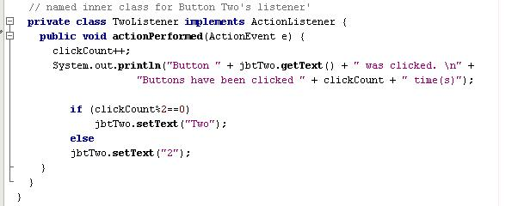
Example with named inner classes, one for listening to each button
Inner class has direct access to all members (even private) of the outer class

Slide 22
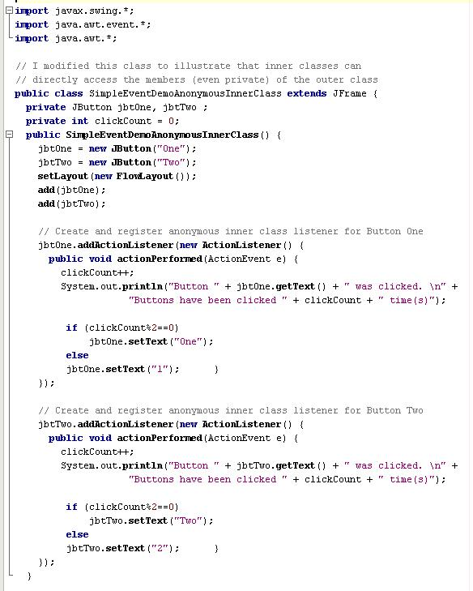
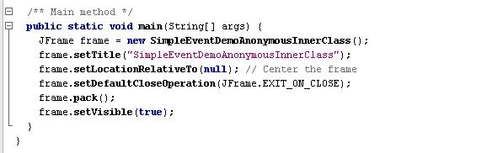
Example with anonymous inner classes, one for listening to each button

Slide 23
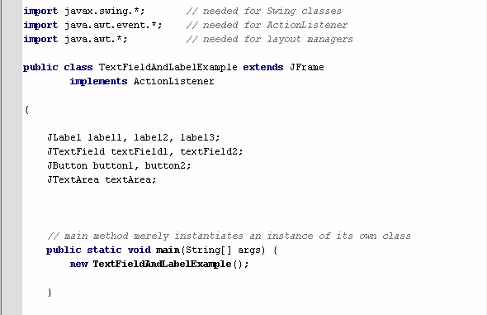

Slide 24
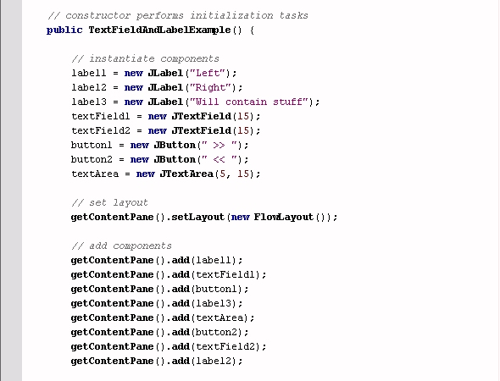
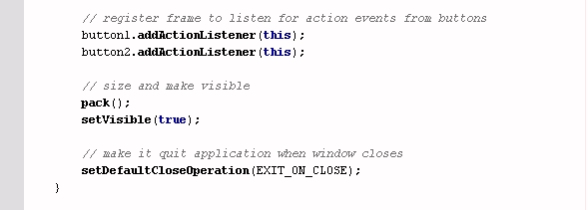

Slide 25
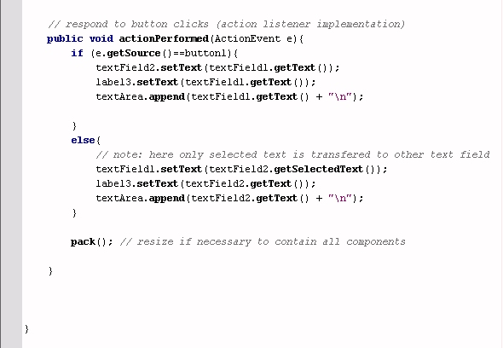
Note use of getText, setText, getSelectedText and append methods.

Slide 26
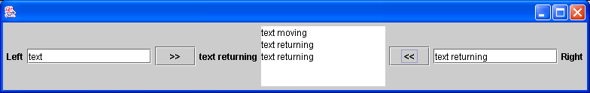

Slide 27
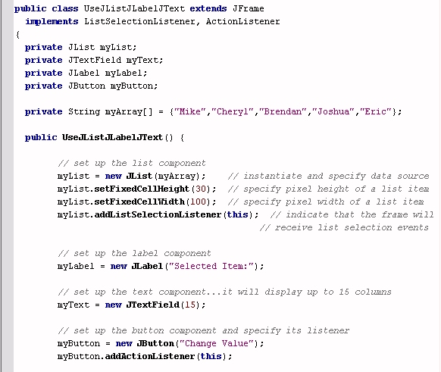
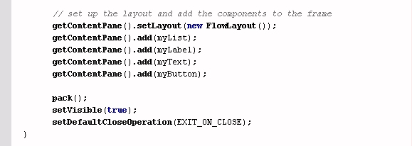
JList Example 1: using lists, text fields, labels, and buttons
Implementing listeners
components
List’s data source

Slide 28
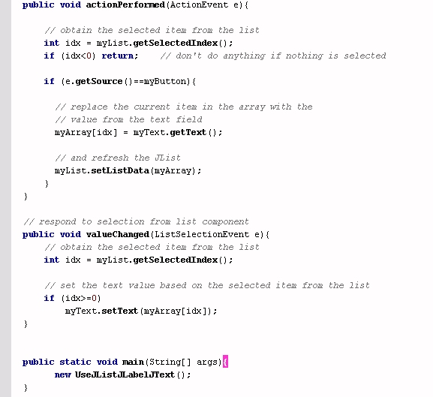
JList Example 1: using lists, text fields, labels, and buttons (con’t.)
When array changes, refresh the list
valueChanged is the ListSelectionListener event handler method
Use list index tp get associated array element

Slide 29
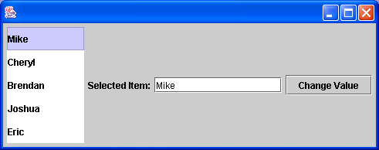
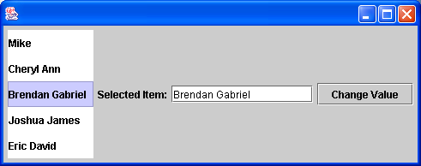

Slide 30
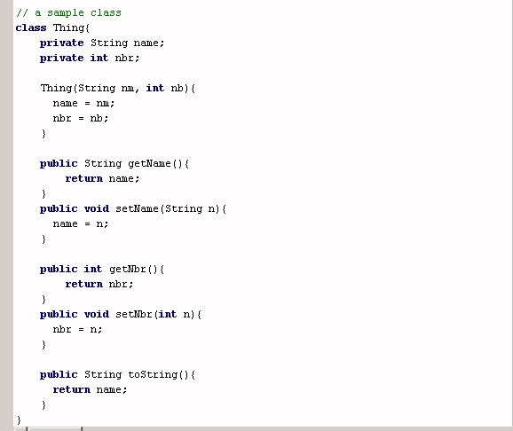
JList Example 2: slightly more complicated…data source is an array of objects
This is the class being used
for the array associated with the JList.
toString is a method that overrides the Object class’s method of the same name. This determines what will be displayed in the JList.

Slide 31
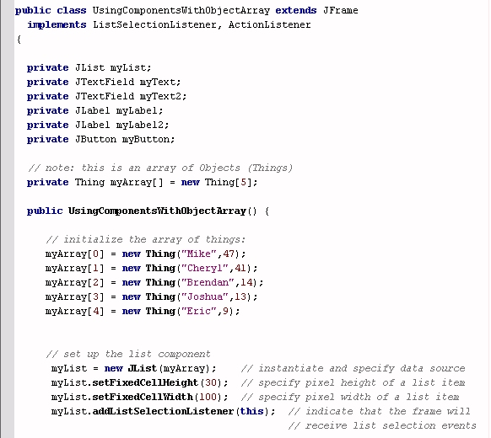
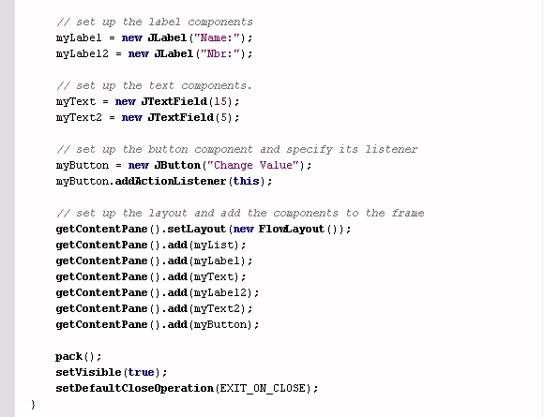
JList Example 2: slightly more complicated…data source is an array of objects

Slide 32
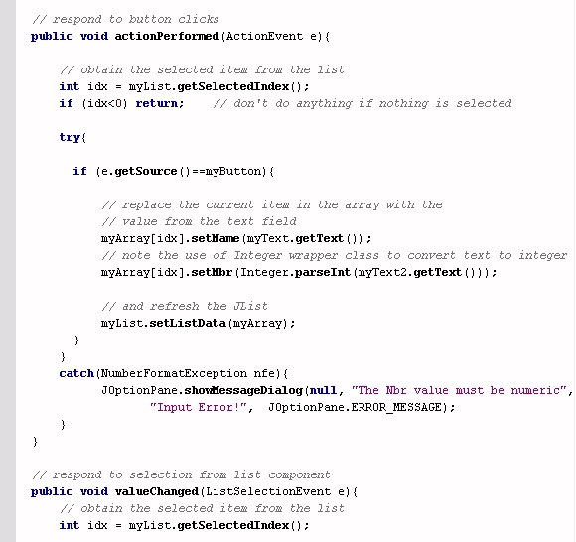
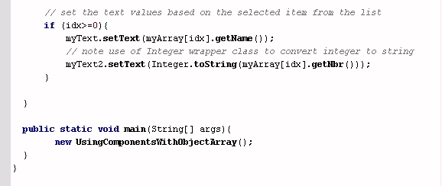
JList Example 2: slightly more complicated…data source is an array of objects

Slide 33
JList Example 2: slightly more complicated…data source is an array of objects
Code in the try block
This may throw an exception
Here we handle the exception

Slide 34
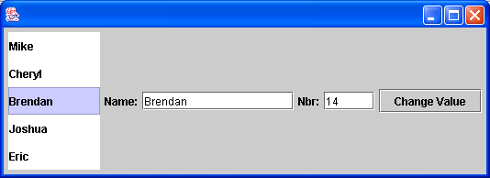
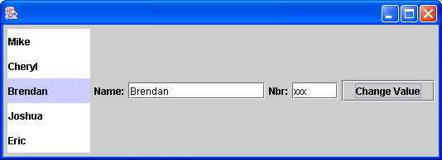
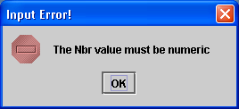

Slide 35
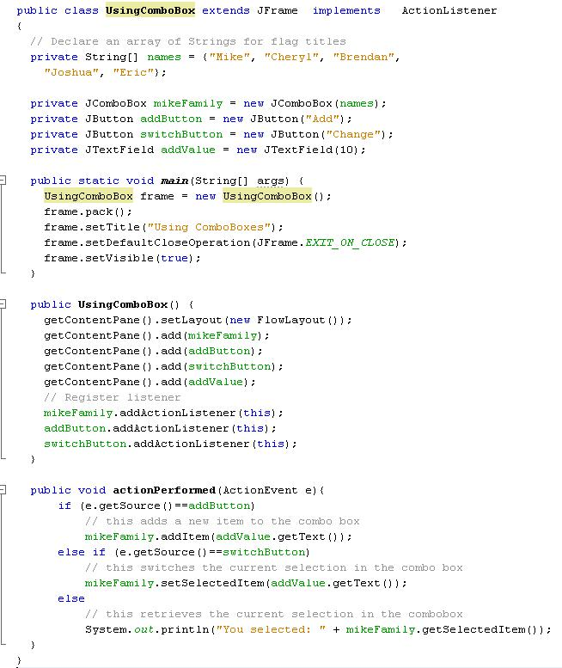
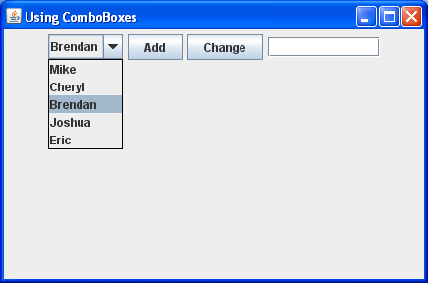

Slide 36
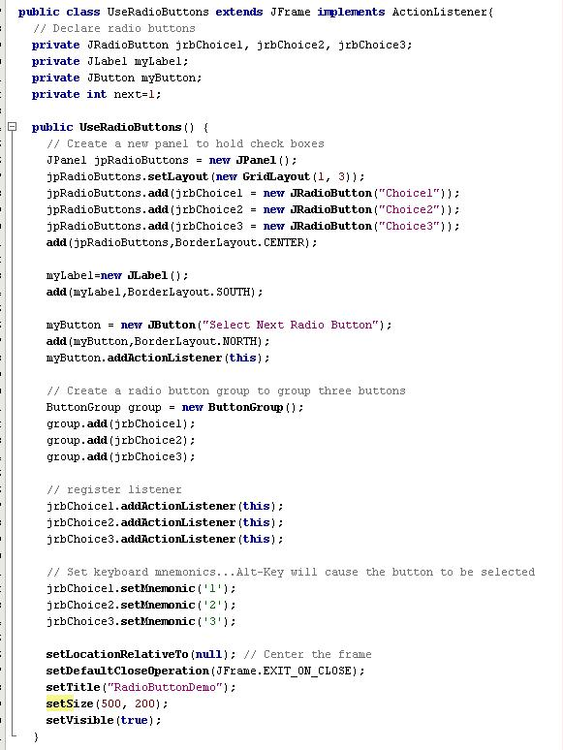
By putting all buttons into a panel, you can place them all together in the same region of the frame’s BorderLayout
By putting all buttons into a ButtonGroup, you ensure that only one will be selected at a time
This code causes the RadioButtons to generate ActionEvents that the frame will listen to
Via setMnemonic, you allow Alt-1, Alt-2 and Alt-3 to select the appropriate RadioButtons

Slide 37
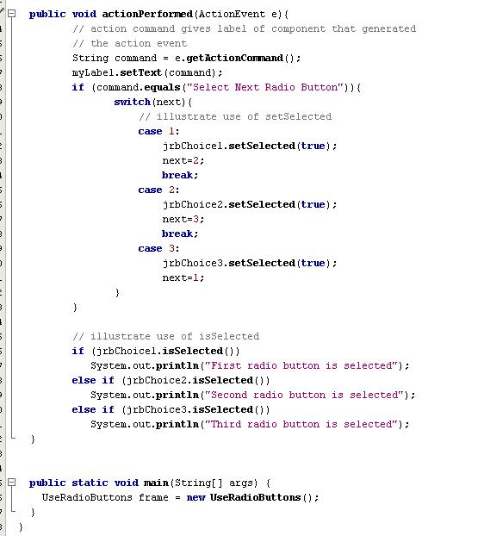
A component’s action command is usually its label, although you can change this
The setSelected method can be used to programmatically change the current RadioButton selection
The isSelected method can be used to determine if a RadioButton is selected

Slide 38
